Slide 1
Vishnu v1: Prototype-Oriented Distillation for Federated Continual Self-Supervised Vision
Student Name: Sathish Kumar R
Guide Name: Dr. Meenakshi K

Slide 2
Abstract
Vishnu-v1 is a privacy-preserving framework enabling continuous self-supervised learning on edge devices. It consolidates evolving knowledge across heterogeneous domains, effectively preserving past representations while reducing communication overhead.

Slide 3
Problem Statement
Current AI systems fail to adapt in real-world scenarios because they rely on static, centralized training that cannot process unlabeled, private data streams without suffering from catastrophic forgetting.

Slide 4
Existing Problems
Catastrophic forgetting
Data heterogeneity
Privacy constraints
Limited label availability
Inefficient adaptation
Notes:
List what are all the problems/gaps in your problem area

Slide 5
Literature Review
Paper Title & Venue | Dataset Used | Key Contributions | Other Observations
Communication-Efficient Learning of Deep Networks from Decentralized Data (AISTATS 2017) | MNIST, CIFAR-10, Shakespeare | Introduced FedAvg (Federated Averaging), the baseline algorithm for training across decentralized devices without sharing data. | Catastrophic forgetting
iCaRL: Incremental Classifier and Representation Learning (CVPR 2017) | CIFAR-100, ImageNet | Proposed using Prototypes (class means) and distillation to prevent forgetting new classes. | Violates privacy
A Simple Framework for Contrastive Learning of Visual Representations (SimCLR) (ICML 2020) | ImageNet, CIFAR-10 | Proved that simple data augmentation and contrastive loss can learn powerful visual features without labels. | Computationally expensive
Federated Continual Learning with Weighted Inter-Client Transfer (FedWeIT) (ICML 2021) | Split CIFAR-100, mini-ImageNet | Decomposed model weights into global and sparse task-specific parameters to reduce interference between clients. | Minimizes interference
Resource-Aware Federated Self-Supervised Learning with Global Class Representations (NeurIPS 2023) | CIFAR-10, CIFAR-100 | Uses knowledge distillation to align diverse client representations with a global anchor model. | Handles non-IID data

Slide 6
Objectives
Develop a framework that enables scalable and privacy-preserving learning.
Achieve robust learning across evolving data distributions.
Ensure efficient long-term knowledge retention while minimizing catastrophic forgetting.
Notes:
List down the objectives of your project as bulleted points. Max 3.
This includes the whole work of Phase I and Phase II

Slide 7
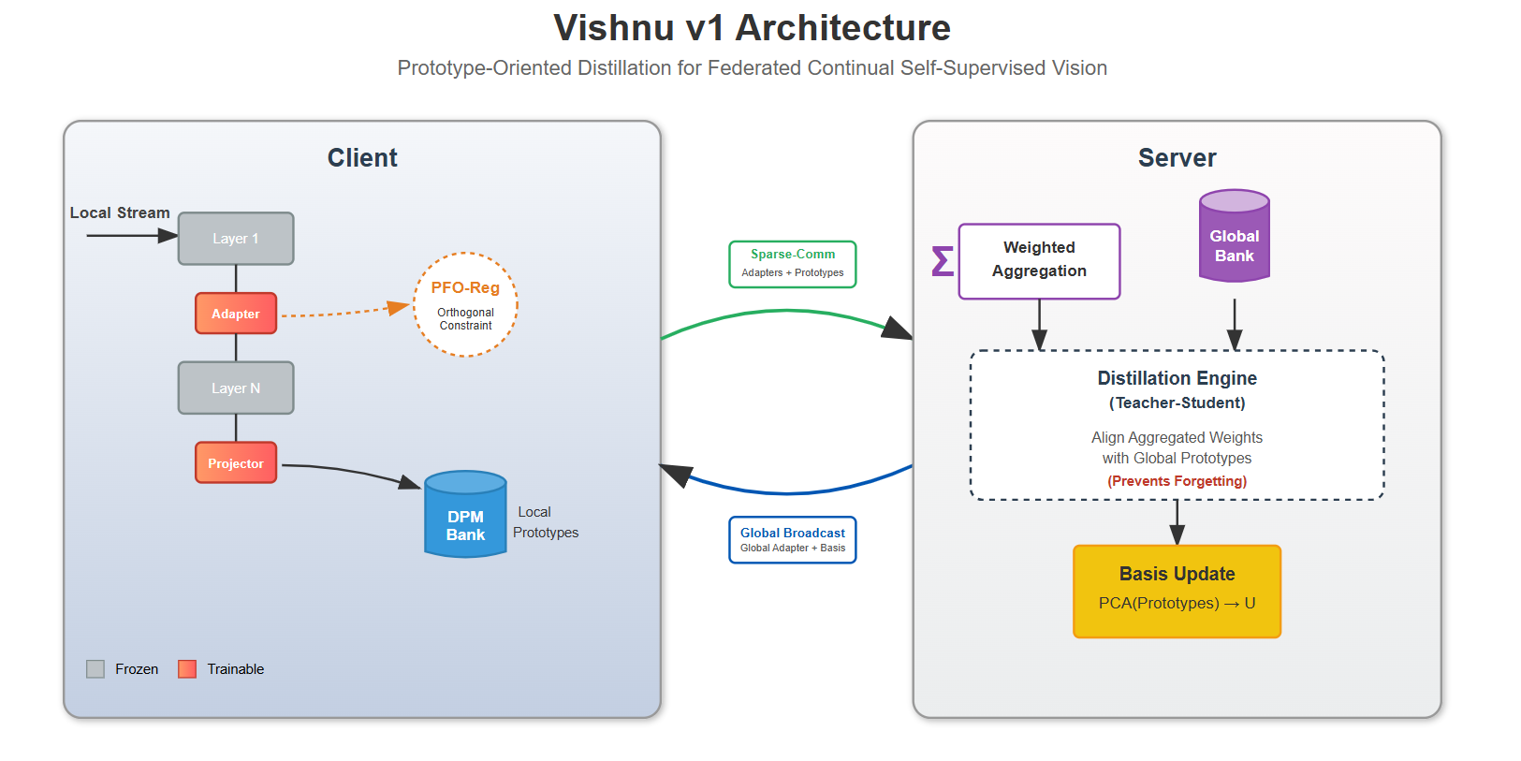
Proposed Architecture

Slide 8
Proposed Module
Information-Bottlenecked Adapter Module
Projective Feature Orthogonalizer
Distributed Prototype Memory Bank
Prototype-Oriented Distillation Engine
Variational Compression Interface

Slide 9
Timeline
Dec: Build IBA-Local Adapters & DPM-Bank Memory
Jan: Implement PFO-Reg & POD-Consolidator Logic
Feb: Validation and Ablation Studies
Mar: Finalize Report & Submission

Slide 10
Thank You

Slide 11
DataSet Description
Notes:
Give the below details of the data
Source of Data
Description – number of rows, column names

Slide 12
Proposed Methodology
Notes:
With a flow chart/work flow diagram, explain the modules of Phase I and Phase II

Slide 13
Algorithm Used
Notes:
Phase I Workflow or Objectives addressed in Phase I

Slide 14
Implementation Details
Notes:
Language Used
Package Used
Algorithms Used

Slide 15
Results and Discussion
Notes:
Detail the contributions done in Phase I

Slide 16
Paper Submission Details
Notes:
Screen shot of acknowledgement proof
Conference/Journal details

Slide 17
Conclusion
Notes:
Result Tables
Result Graphs

Slide 18
Future Work
Notes:
Bulleted points for Phase II Plan

Slide 19
References
Notes:
List the references In IEEE format. Minimum 5, Max 10.

